Slide 1

MACHINE LEARNING PROJECT COVID-19 CLASSIFICATION PROJECT BY SIMI SUDHAKARAN

Slide 2
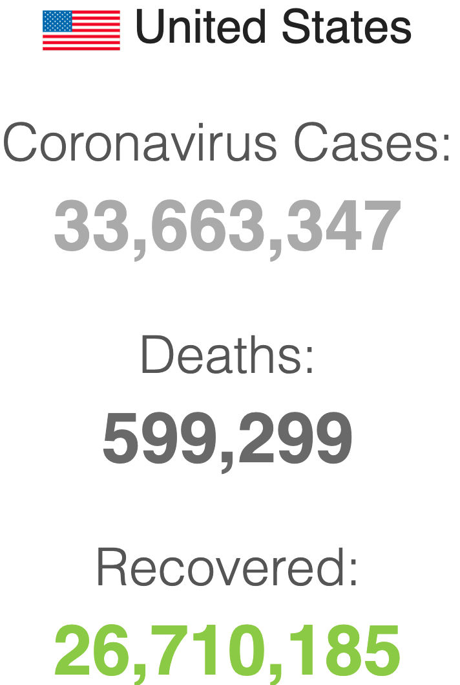
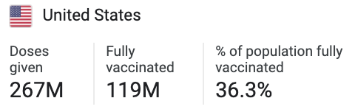
PROJECT OVERVIEW
The new coronavirus disease(COVID-19) has caused more than 33million illnesses and ~600k deaths in the U.S. as of May 14, 2021 according to data from John Hopkins University. Although now the death rate in US has been going down significantly because of the availability of the highly efficient Vaccinations. 119Million people have been fully vaccinated which is close to 36.3% of the US population and 47% have received the first dose. Lets go through the statistics and machine learning classification algorithms to actually calculate this using the last 5months data.

Slide 3
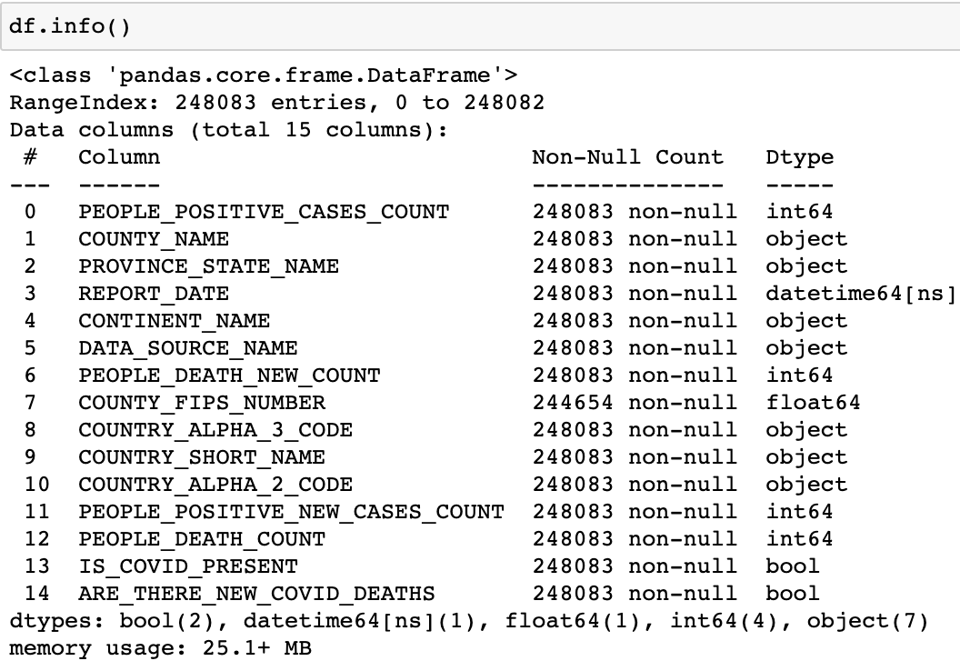
DATASET
Data from Data.World(Health) :
https://data.world/covid-19-data-resource-hub/covid-19-case-counts
Shape of the dataset (248083, 15):

Slide 4
LIBRARIES USED
Numpy
Pandas
Matplotlib
Seaborn
Scikit Learn:
Standard Scalar
PCA
Train Test Spilt
Logistic Regression
GridSearchCV
KNeighborClassifier
SVC
Decision Tree
Random Forest Classifier
Adaboost
Accuracy

Slide 5
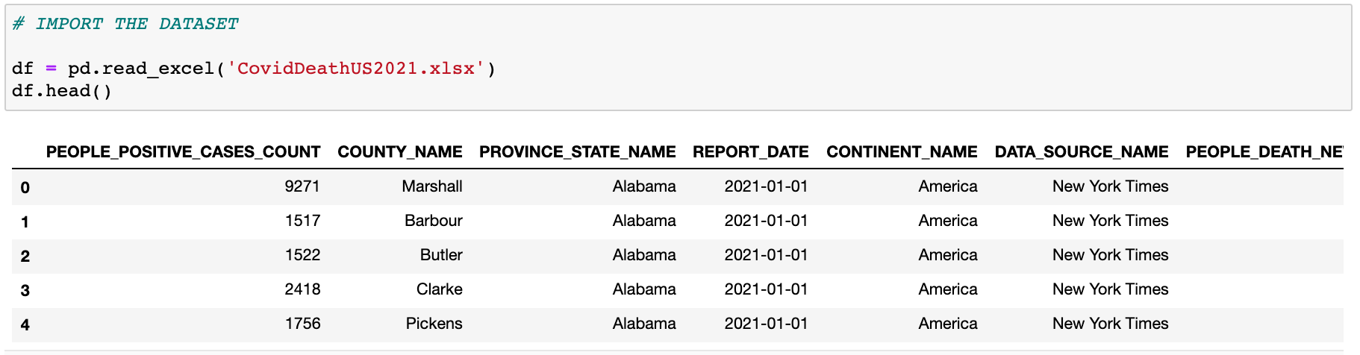
IMPORTING THE DATASET

Slide 6
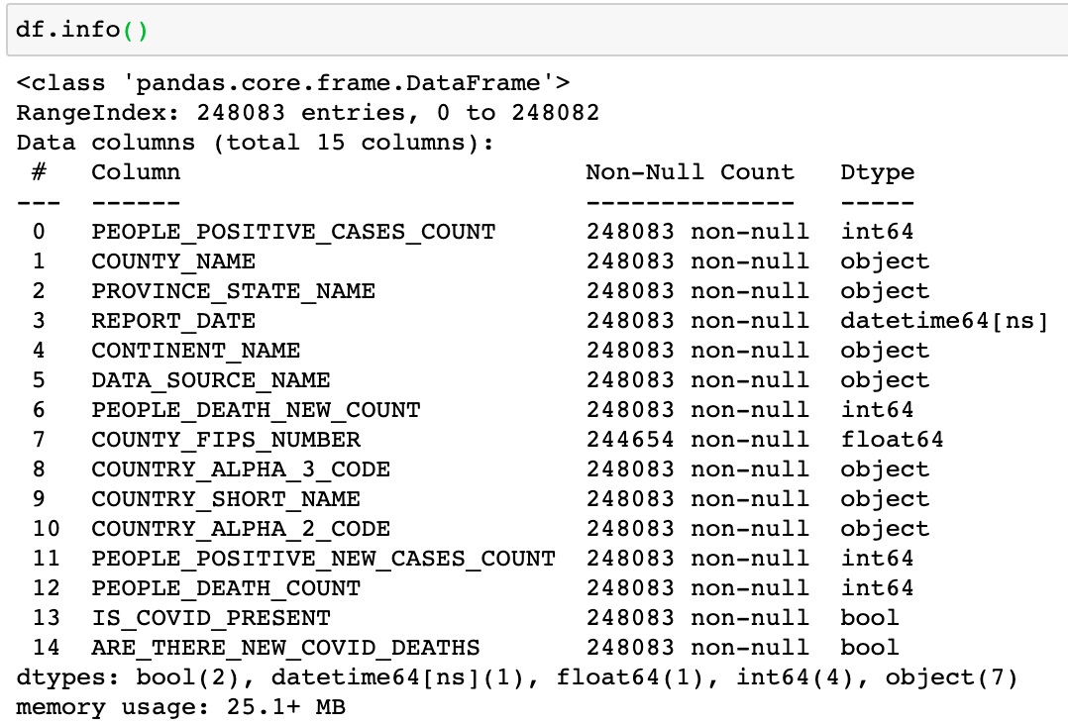
DATA PREPROCESSING
Checking for the nulls

Slide 7
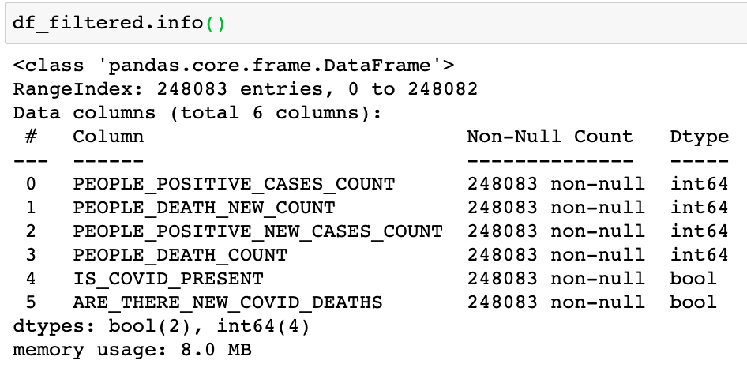
Filtering the dataset

Slide 8
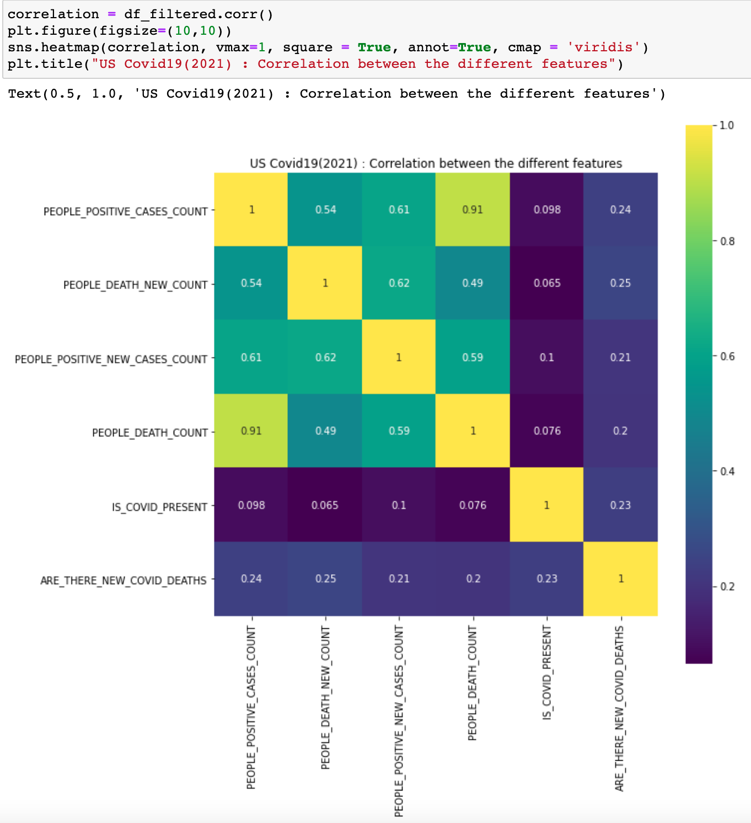
FEATURE CORRELATION
Highly correlated features

Slide 9
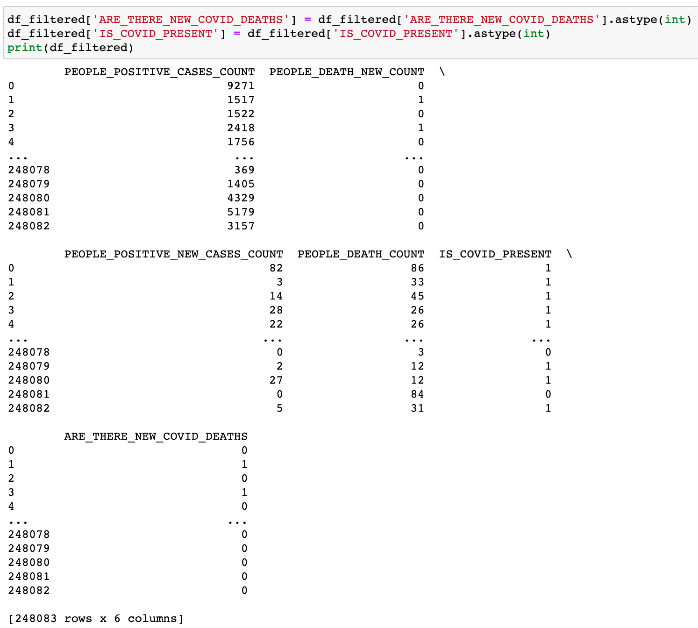
CONVERTING CATEGORICAL VARIABLES TO DUMMY VARIABLES
True/False to 1/0s

Slide 10
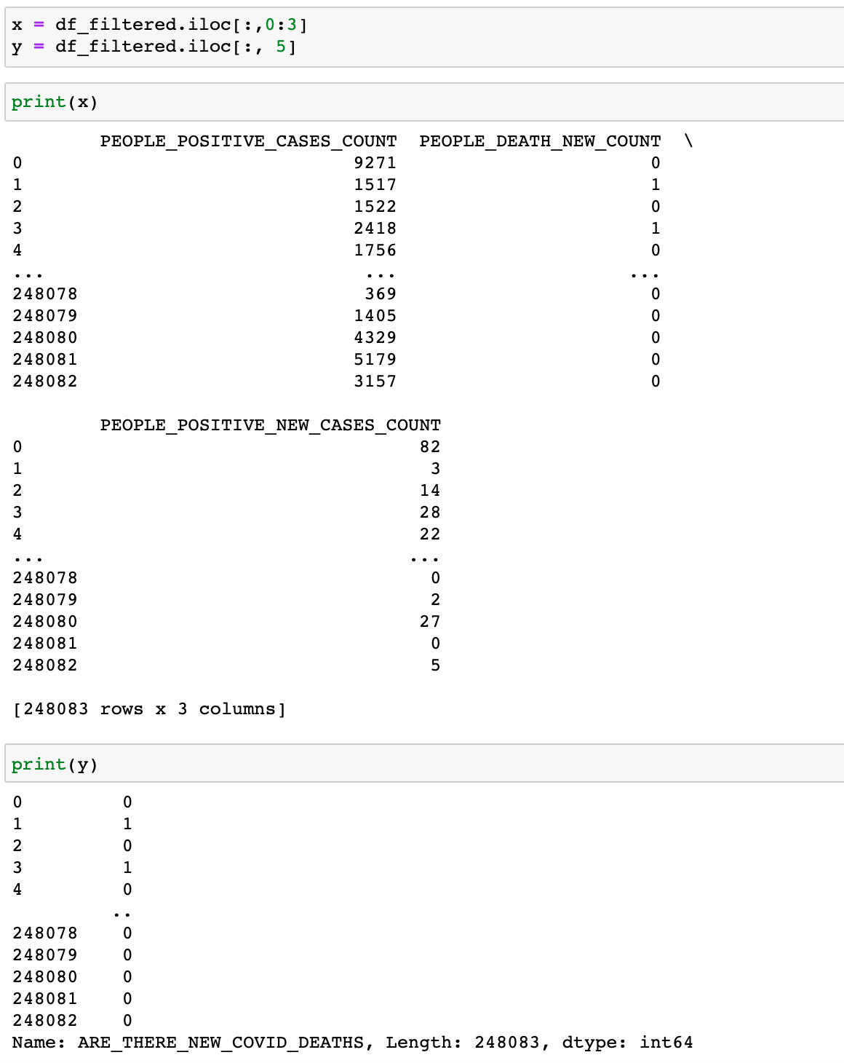
TARGET AND FEATURE VARIABLES
X : feature variable
Y : Target Variable

Slide 11
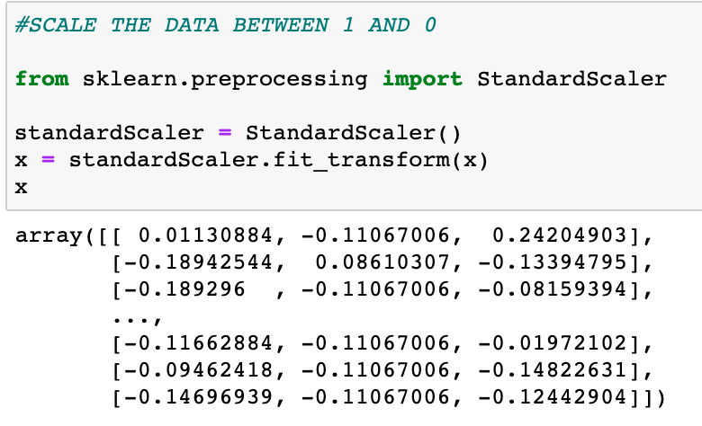
SCALING THE DATA

Slide 12
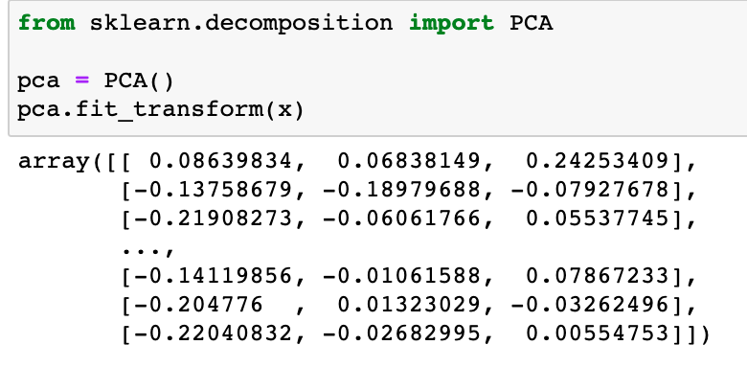
PRINCIPAL COMPONENT ANALYSIS

Slide 13
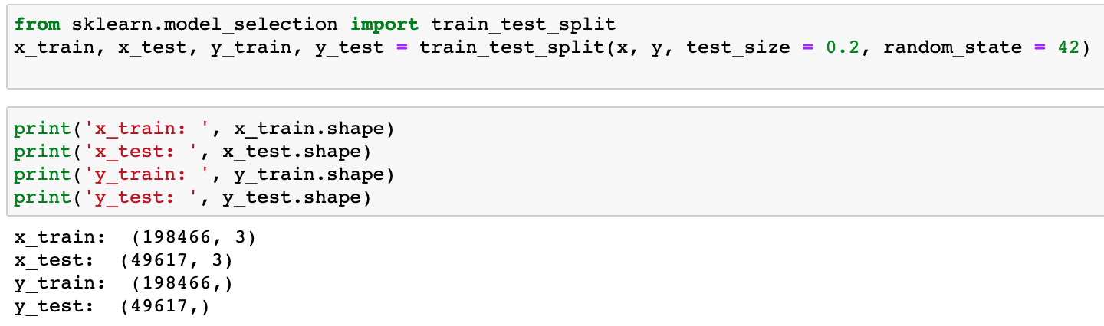
TEST AND TRAIN DATA

Slide 14
CLASSIFICATION ALGORITHMS

Slide 15
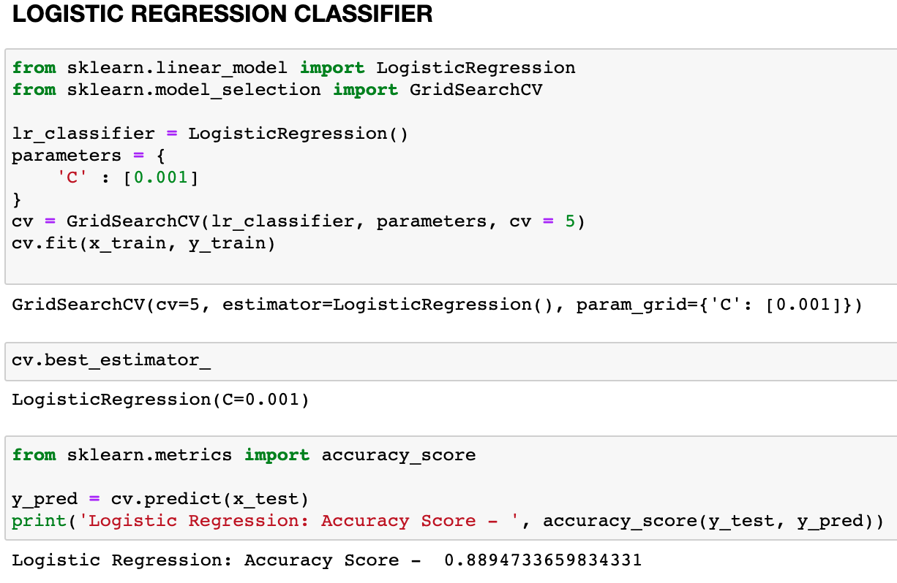
LOGISTIC REGRESSION CLASSIFIER

Slide 16
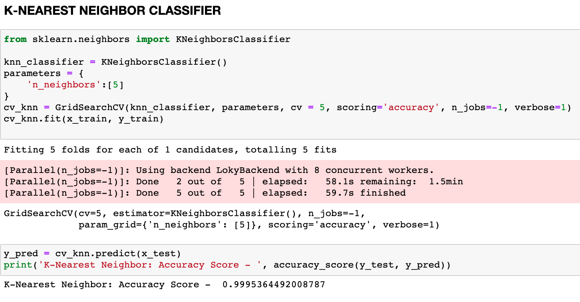
K-NEAREST NEIGHBOR CLASSIFIER

Slide 17
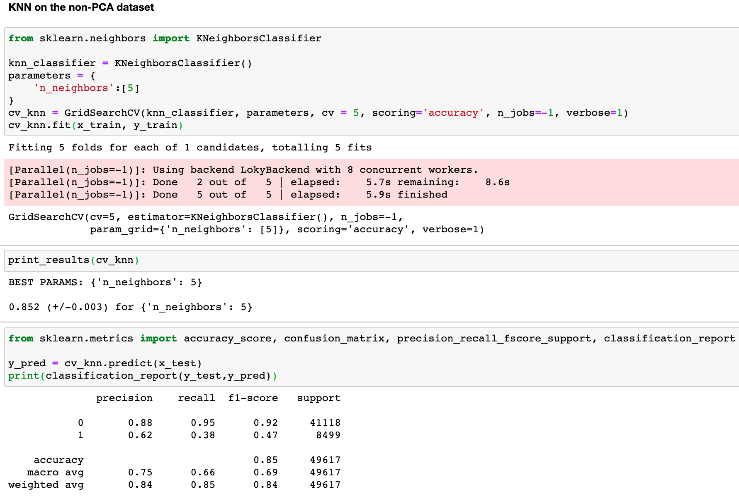
KNN on a non-PCA dataset

Slide 18
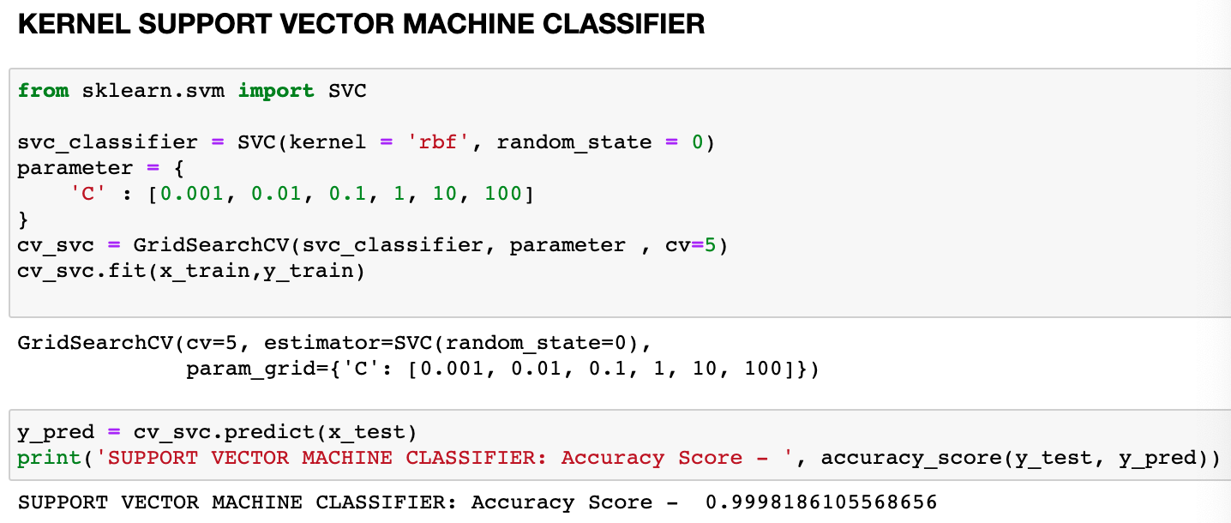
KERNEL SUPPORT VECTOR MACHINE CLASSIFIER

Slide 19
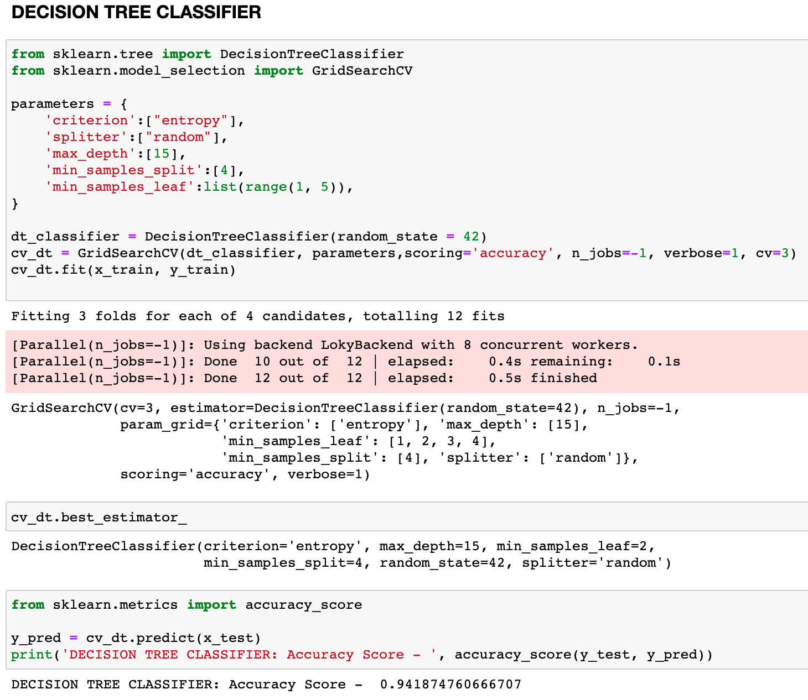
DECISION TREE CLASSIFIER

Slide 20
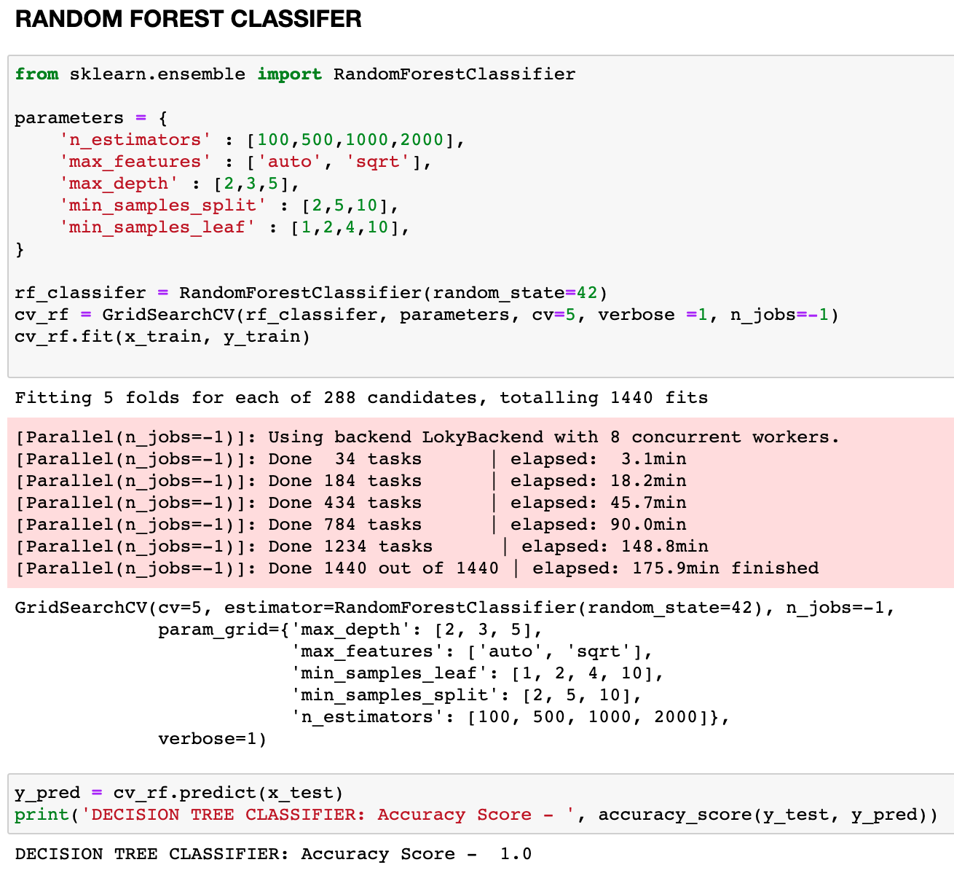
RANDOM FOREST CLASSIFIER

Slide 21
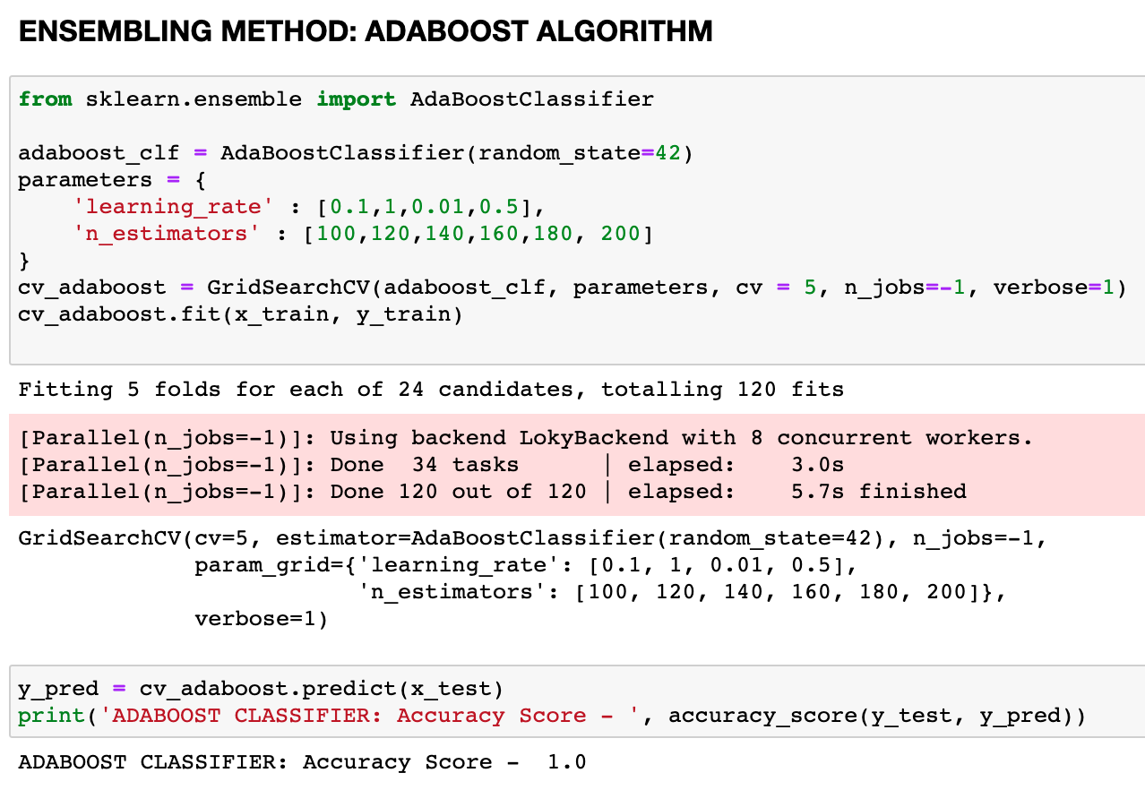
ENSEMBLING METHOD: ADABOOST ALGORITHM

Slide 22
COMPARING ALL THE ACCURACIES
S.No | CLASSIFICATION ALGORITHM | ACCURACY SCORE
1 | Logistic Regression Classifier | 88.94%
2 | K-Nearest Neighbor Classifier | 99.95% 85%(non-scaled data)
3 | Kernel Support Vector Machine Classifier | 99.98%
4 | Decision Tree Classifier | 94.19%
5 | Random Forest Classifier | 100%
6 | Ensemble: Adaboost | 100%

Slide 23
THANK YOU!!

